Slide 1
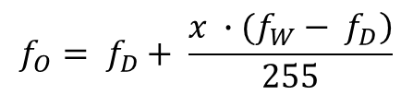
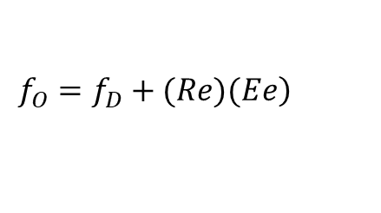
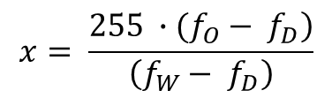
Photodiode Array
Current-to-Frequency Converter
Output
Light
S2
S3
S0
S1
OE
Color Filter Selection
Frequency Scale Selection
$$\left.f_{O}=f_{D}+(Re)(Ee\right)$$
$$f_{O}= f_{D}+ \frac{\left.x ∙(f_{W}− f_{D}\right)}{255}$$
$$x= \frac{\left.255 ∙(f_{O}− f_{D}\right)}{\left(f_{W}− f_{D}\right)}$$

